Slide 1
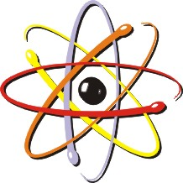
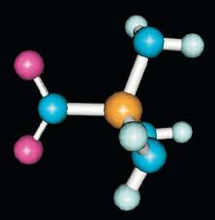
Bonding

Slide 2
Types of bonds to start
(What are we talking about?)
Intramolecular Bond
  (Bond within a molecule)
Intermolecular force of attraction
  (Attraction between 2 molecules)
  Usually Dipoles, hydrogen bonds, or dispersion forces
H-H
……………
H-H

Slide 3
2 types of Bonds
Covalent
Ionic
A bond between 2 elements (Nm-Nm)
Involves the sharing of electrons
E.N. difference < 1.7
Bond between 2 elements (M-Nm)
Involves the transfer of electrons
E.N. Difference > 1.7

Slide 4
Bond characteristics
Covalent
Ionic
Weaker bonds
Low B.P., High Vapor Pressure
Soft, Brittle
Insoluble in water
Stronger bonds
High B.P., Low Vapor Pressure
Hard
Crystals
Soluble in water

Slide 5
Lewis Dots
Show only the valence e-, (not Kernel e-)
The goal with bonding is to achieve an outer valence of 8 Val e- (like a noble gas)
***To achieve a noble gas configuration***
        (Rule of Octet)
Metals (Grp 13) (Grp 14) NM
Lose e- Gain e-
Take on Noble Gas Configuration of the
Noble Gas Noble Gas
Before it! After it!

Slide 6
Draw Lewis Dot Structures for water and carbon dioxide

Slide 7
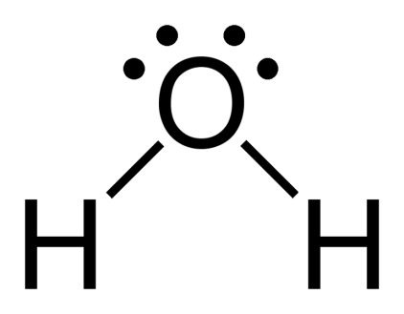
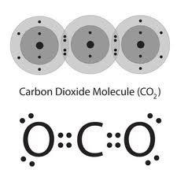
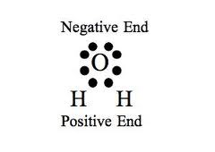
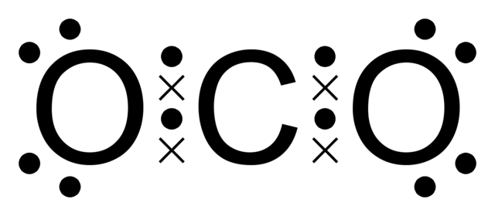
Lewis Dots (Covalent)
Form “True molecules”
Remember the “Rule of H O N C”

Slide 8
Draw Lewis Structures for hcl and methane

Slide 9

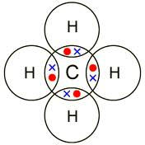
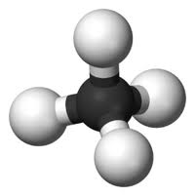
Lewis Dots (Covalent)
Form “True molecules”

Slide 10
Ionic Bonding
Draw the electron dot structure for sodium
Draw the electron dot structure for chlorine

Slide 11
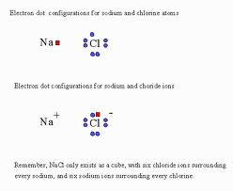
Lewis Dots (ionic)
Form “ionic compounds”

Slide 12
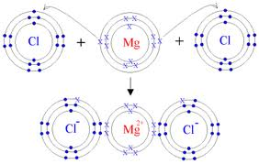
Lewis Dots (ionic)
Form “ionic compounds”

Slide 13
Let’s talk polarity
Bond
Polarity
Molecule
Polarity

Slide 14
Let’s talk polarity in a bond
Bond
Covalent (Nm-Nm)
Ionic (M-Nm)
Non-polar
Diatomics
Polar
H₂O, CO₂
Polar
Remember this 1 Thing
All bonds are polar….except diatomics
Br₂ I₂ N₂ Cl₂ H₂ O₂ F₂

Slide 15
Let’s talk polarity in a Molucule
Molecule
SN
A P
Symmetrical
Non-polar
Asymmetrical
Polar
Remember this…..
It’s so simple, it’s a snap

Slide 16
Let’s talk shapes and polarity
Bond
Polarity
Molecule
Polarity

Slide 17
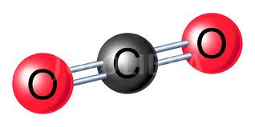
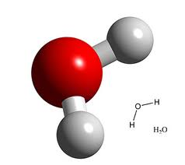
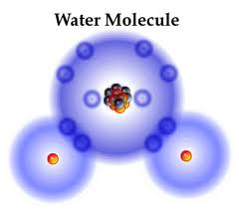
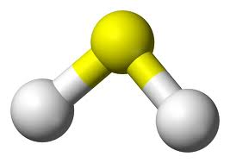
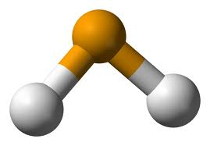
Shapes of molecules
1. Linear
Seen with only 2 elements and CO₂
H-H H-Cl NaCl O=C=O
2. Bent
Seen with Oxygen (Grp 16) central with 2 other elements!
H₂O H₂S H₂Se H₂Te
S
Se
H
H
H
H

Slide 18
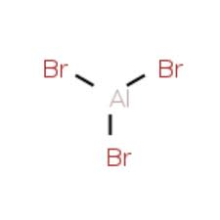
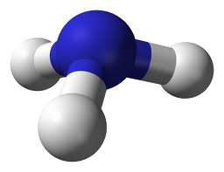
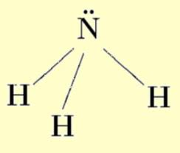

Shapes of molecules
3. Trigonal Planar
Seen with Al (13) central with 3 other elements
AlBr₃
4. Trigonal Pyramidal
Seen with Nitrogen (15) central with 3 other elements!
NH₃

Slide 19
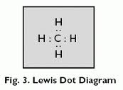
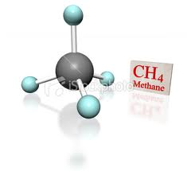
Shapes of molecules
5. Tetrahedral
Seen with Carbon (14) central with 4 other elements!
CH₄

Slide 20
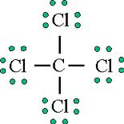
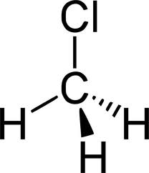
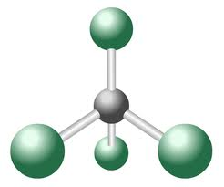
Shapes of molecules
4. Tetrahedral (Continued)
Seen with Carbon (14) central with 4 other elements!
CCl₄ CH₃Cl

Slide 21
6 kinds of forces of attraction
4 - intramolecular (with-in)
2 - intermolecular (IMF)
Name | Examples | Characteristics
1. Network Solids | Diamond, Graphite SiC Silicon Carbide SiO₂ Silicon Dioxide | Strongest, Hardest ^^^^^ BP, MP Insoluble in water Poor conductor of electricity

Slide 22
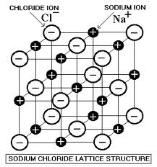
6 kinds of forces of attraction
4 - intramolecular (with-in)
2 - intermolecular (IMF)
Name | Examples | Characteristics
2. Ionics | Any M-Nm (Ionic compound) ****Crystal Lattice**** | Strong, Hard, Brittle ^^^^ BP, MP Soluble in water ***** (S) Poor conductor of electricity (l, aq) excellent conductor of Electricity ****Why? Mobile Ions!
 | Remember, Like Dissolves Like (Molecule Ion Attraction)

Slide 23
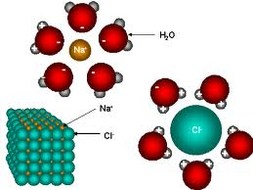
6 kinds of forces of attraction
4 - intramolecular (with-in)
2 - intermolecular (IMF)
Name | Example | Characteristic
2. Ionic continued | Remember, Like Dissolves Like (Molecule Ion Attraction) | This is why salts (ionic-polar) dissolve in water (polar)

Slide 24
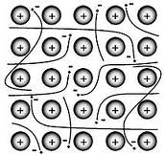
6 kinds of forces of attraction
4 - intramolecular (with-in)
2 - intermolecular (IMF)
Name | Example | Characteristic
3. Metallic bonds | Metals Na(s), Mg(s) ************* Positive ions immersed in a “SEA OF MOBILE ELECTRONS” | Strong, Hard, Soft ^^^ BP, MP Luster – shine Mallable – Sheets Ductile – Wire ****Excellent conductor of Heat and Electric

Slide 25
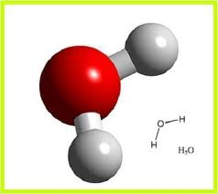
6 kinds of forces of attraction
4 - intramolecular (with-in)
2 - intermolecular (IMF)
Name | Example | Characteristic
4. Molecular Compounds | All covalent Molecules | Soft, Brittle ^^ B.P., M.P. Insoluble in water Poor conductor of electricity

Slide 26
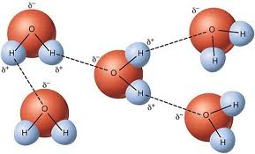
6 kinds of forces of attraction
2 - intermolecular (IMF)
Name | Example | Characteristic
5. Hydrogen Bonds | Seen with: HF , NH₃ , H₂O Strongest why? Most Polar!! | A weak IMF of attraction between 2 stronger polar molecules (Dipoles)!!! *****Although weak, they are strong enough to give water it’s characteristic High B.P. and keep water in a (l) state @ room temperature!
Notice the alignment of the
H (+) to the O (-) sides

Slide 27
6 kinds of forces of attraction
2 - intermolecular (IMF)
Name | Example | Characteristic
5. Van der Waals “London disperssion forces” | Seen with: (diatomics) F_{2(g)}, Cl_{2 (g)} , Br_{2(l)} I_{2(s)} , H_{2(g)}, N_{2(g)} And CO₂ strongest based on size (note Solid therefore it is the strongest example) | Weakest IMF of attraction between 2 non-polar molecules or a very weak polar molecule (dipole-dipole) HCl. Therefore, usually seen with Diatomic gases only! Active during deposition (G→S) Broken during Sublimation (S→G)

Slide 28
Van der waals forces
Remember Ideal and Real Gases??
Ideal gas
T P
deposition
…..
To Act like a Real gas
VDW
sublimation
T P
To act like an Ideal gas

Slide 29
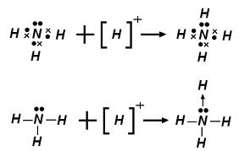
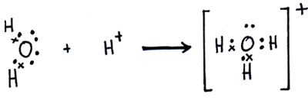
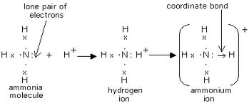
Coordinate covalent bond
A bond between 2 elements where both electrons in the bond come from the same element
+
NH₃ + H⁺ → NH₄⁺

Slide 31
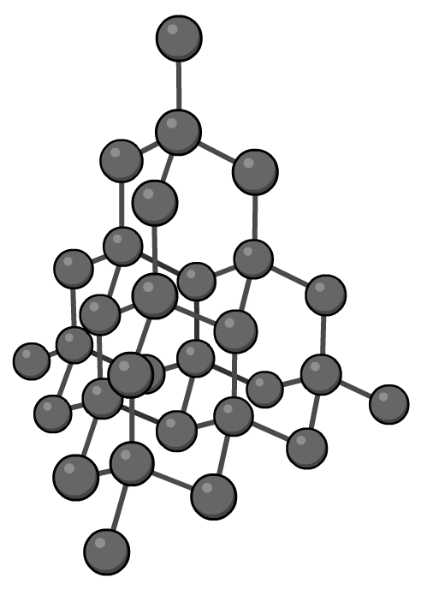

The structure of diamond
Allotropes are different forms of the same element.
Diamond is an allotrope of carbon, and is an example of a macromolecular crystal.
Each carbon atom is bonded by covalent bonds to four other carbon atoms, creating a rigid, very strong 3D structure.

Slide 32


Properties of diamond
Notes:
Photo credit: RTimages / shutterstock.com
Teacher notes
At the end of the animation, there is a dot-and-cross diagram showing the bonding between carbon atoms in diamond. Students could be reminded that this is a 2D interpretation only, and that the position of the atoms to each other does not reflect their actual position in the 3D structure.

Slide 33
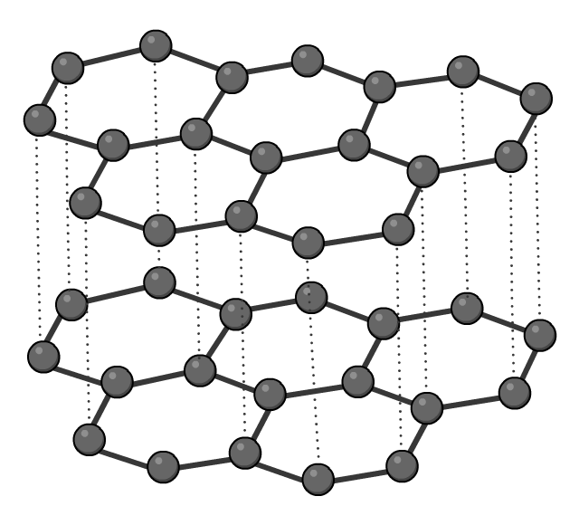
The structure of graphite
Graphite is another allotrope of carbon. Like diamond, it is a macromolecular crystal. However, it has very different physical properties because the carbon atoms are arranged in a different way.
Each carbon atom is covalently bonded to three others in the same 2D plane, forming layers.
These layers are held weakly together by van der Waals forces, not covalent bonds.

Slide 34
Properties of graphite
Notes:
Photo credit: Armin Rose / shutterstock.com

Slide 35
Allotropes of carbon

Slide 36
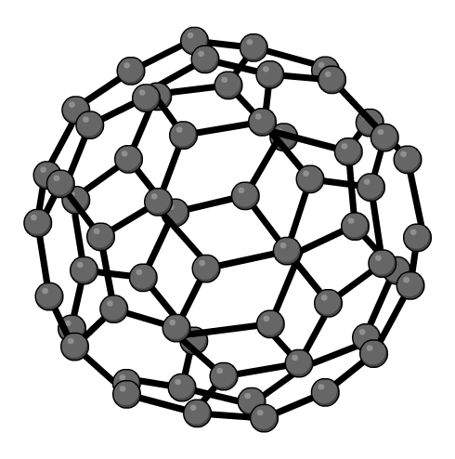
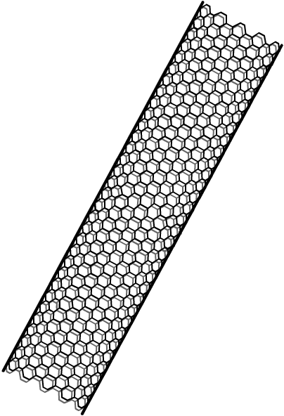
Other allotropes of carbon
Another class of carbon compounds are the fullerenes.
Buckminsterfullerene is one type of fullerene. It contains 60 carbon atoms, each of which is bonded to three others by two single bonds and one double bond.
Carbon nanotubes are another type of fullerene. They are cylindrical carbon molecules. They have many potential applications, such as transporting drugs around the body and as components in electrical transistors.

Slide 37
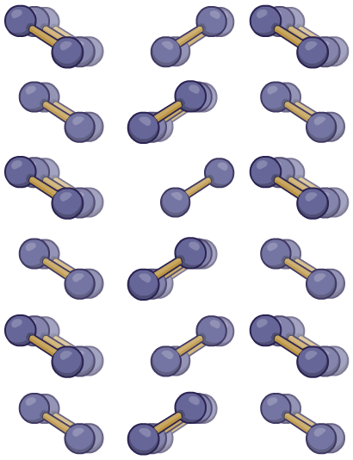
The structure of iodine
Solid iodine has a molecular structure consisting of a regular arrangement of iodine molecules (I₂) held in place by van der Waals forces.
The melting point of iodine is low (387 K) compared to that of diamond, because less energy is required to break van der Waals forces than covalent bonds.

Slide 38
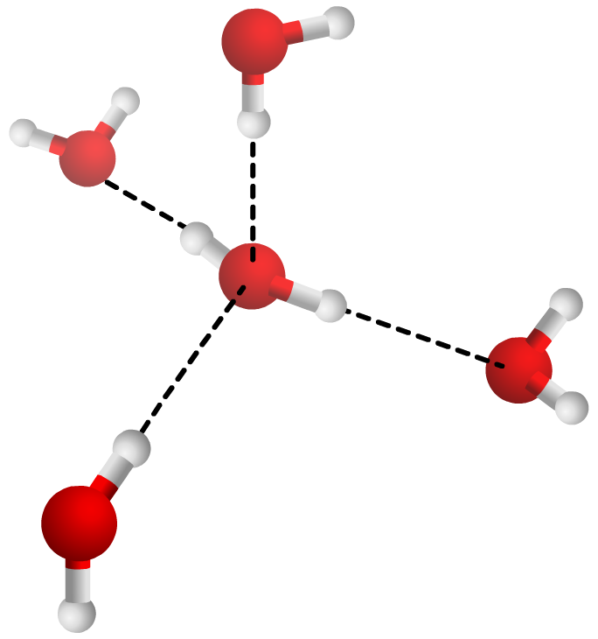
The structure of ice
In ice, water molecules form four hydrogen bonds with neighboring water molecules, creating a repeating tetrahedral structure.
Usually a solid is more dense than the same material in its liquid phase. However, cold water (around 4 °C) is denser than ice.
hydrogen
bond
This is because not all the water molecules are hydrogen bonded, and the mean distance between molecules is less than the hydrogen bond length.

Slide 39
Covalent crystals: true or false?

Slide 40
Covalent structures

