Slide 1
Do now:
Define covalent bond:
Draw each molecule and then state the number of covalent bonds in each molecule.
  propane
  ethanal
  3-pentanone

Slide 2
Intermolecular Forces
Sneak preview during organic unit

Slide 3
Intermolecular forces (IMF)
Force of attraction from one molecule to another.
These are not the covalent bonds that hold the molecule together – they are outside the molecule.
Gases do NOT have strong IMF. That is why the molecules whiz around and fill up the whole container.
Solids have the strongest IMF.

Slide 4
Melting Point and Boiling Point
Boiling point (b.p.) → the temperature of the phase change from liquid to vapor (gas)
B.P. is also the temperature of the transition from gas to liquid
Melting point (m.p.) → the temperature of the phase change from solid to liquid or from liquid to solid
M.p. and b.p. are related. If the m.p. is low, the b.p. will also be low.

Slide 5
Do Now. Copy and complete. Make this a full page.
molecular formula | structural formula | name | leave this column blank for now
 |  | ethane
 |  | chloroethane
 |  | ethanal
 |  | ethanol
 |  | ethanoic acid

Slide 6
IMF's listed from strongest to weakest
Hydrogen bonding
Dipole-dipole attraction
Dispersion forces

Slide 7
Hydrogen bonding
Strongest IMF
NOT a bond
The hydrogen of one molecule is attracted to the N, O, or F atom on another molecule.
Practice: draw 2 water molecules and show the H bonding
Practice: draw 2 ethanol molecules and show the H bonding

Slide 8
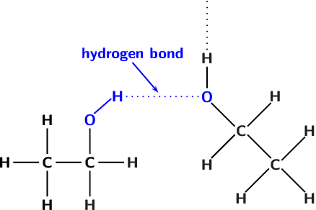
H bonding in an alcohol

Slide 9
Hydrogen bonding
Practice: draw 2 ethanoic acid molecules and show the H bonding

Slide 10
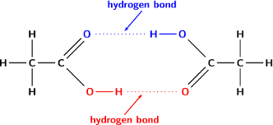
H bonding in an acid

Slide 11
Relationship of b.p. to IMF:
molecular formula | name | boiling point (ºC) | type of IMF
 | ethane | -89
 | chloroethane | 12
 | ethanal | 20
 | ethanol | 78
 | ethanoic acid | 118

Slide 12
Dipole-Dipole attraction
Attraction of one polar molecule to another polar molecule.
Present in aldehydes and ketones.

Slide 13
Dispersion forces
Weakest IMF
Dispersion force increases as size increases
Bigger molecular size→ higher dispersion force→ higher b.p. → likely to be a liquid at room temperature

Slide 14
Dispersion forces
Practice: Why is octane a liquid while propane is gas?
Octane has a higher m.p. and b.p.,
because octane has higher IMF.
Dispersion forces are higher in octane, because it is a bigger molecule.

Slide 15
Relationship of b.p. to IMF:
molecular formula | name | boiling point (ºC) | type of IMF
 | ethane | -89 | dispersion
 | chloroethane | 12 | dispersion
 | ethanal | 20 | dipole-dipole
 | ethanol | 78 | H bonding
 | ethanoic acid | 118 | H bonding

Slide 16
The End of IMF's!

